Slide 1

KSDE Board Presentation
Educator Evaluation Systems Update
Scott Myers and Bill Bagshaw
Wednesday, July 9, 2014
KSDE

Slide 2
Evaluations Introduction
Three Pilot Years
    First 2 Years KSDE Developed KEEP
    Third Year all Districts Selected and Piloted
2013-2014 Trainings for Full Implementation in 2014-2015
    Student Growth Measures selected and submitted
    Final Summative Rating to be Implemented
All Evaluations in the State of Kansas 2014-2015 are in Full Implementation

Slide 3

Defining Educator Evaluation Systems
In Kansas

Slide 4
WAIVER - Principle 3, 6 Guidelines
Implement teacher and principal evaluation and support systems that:
Are used for continual improvement of instruction
Use at least 3 performance levels
Use multiple measures including student growth as significant factor
Are used to evaluate on a regular basis
Provide clear, timely, and useful feedback
Are used to inform personnel decisions

Slide 5

Student Growth Measures
Currently Used Examples
State Assessments must be used in grades and subjects areas where they are given
Commercially Developed Assessments
Locally Created Assessments

Slide 6

Student Growth Measures
Default Lists
Default Lists of Student Growth Measures Assessments:
Elementary
Middle School
High School

Slide 7
Teachers and Leaders
Co-Construct the Educator Evaluation
Student Learning
Content Knowledge
Instructional Practice Protocol Summary Rating
FINAL SUMMATIVE Rating
Instructional Practice
Professional Responsibility
Student Growth Measure
Student Growth Measure
Student Growth Measures Summary Rating
Student Growth Measure
(SGMs + IPP = FSR)

Slide 8
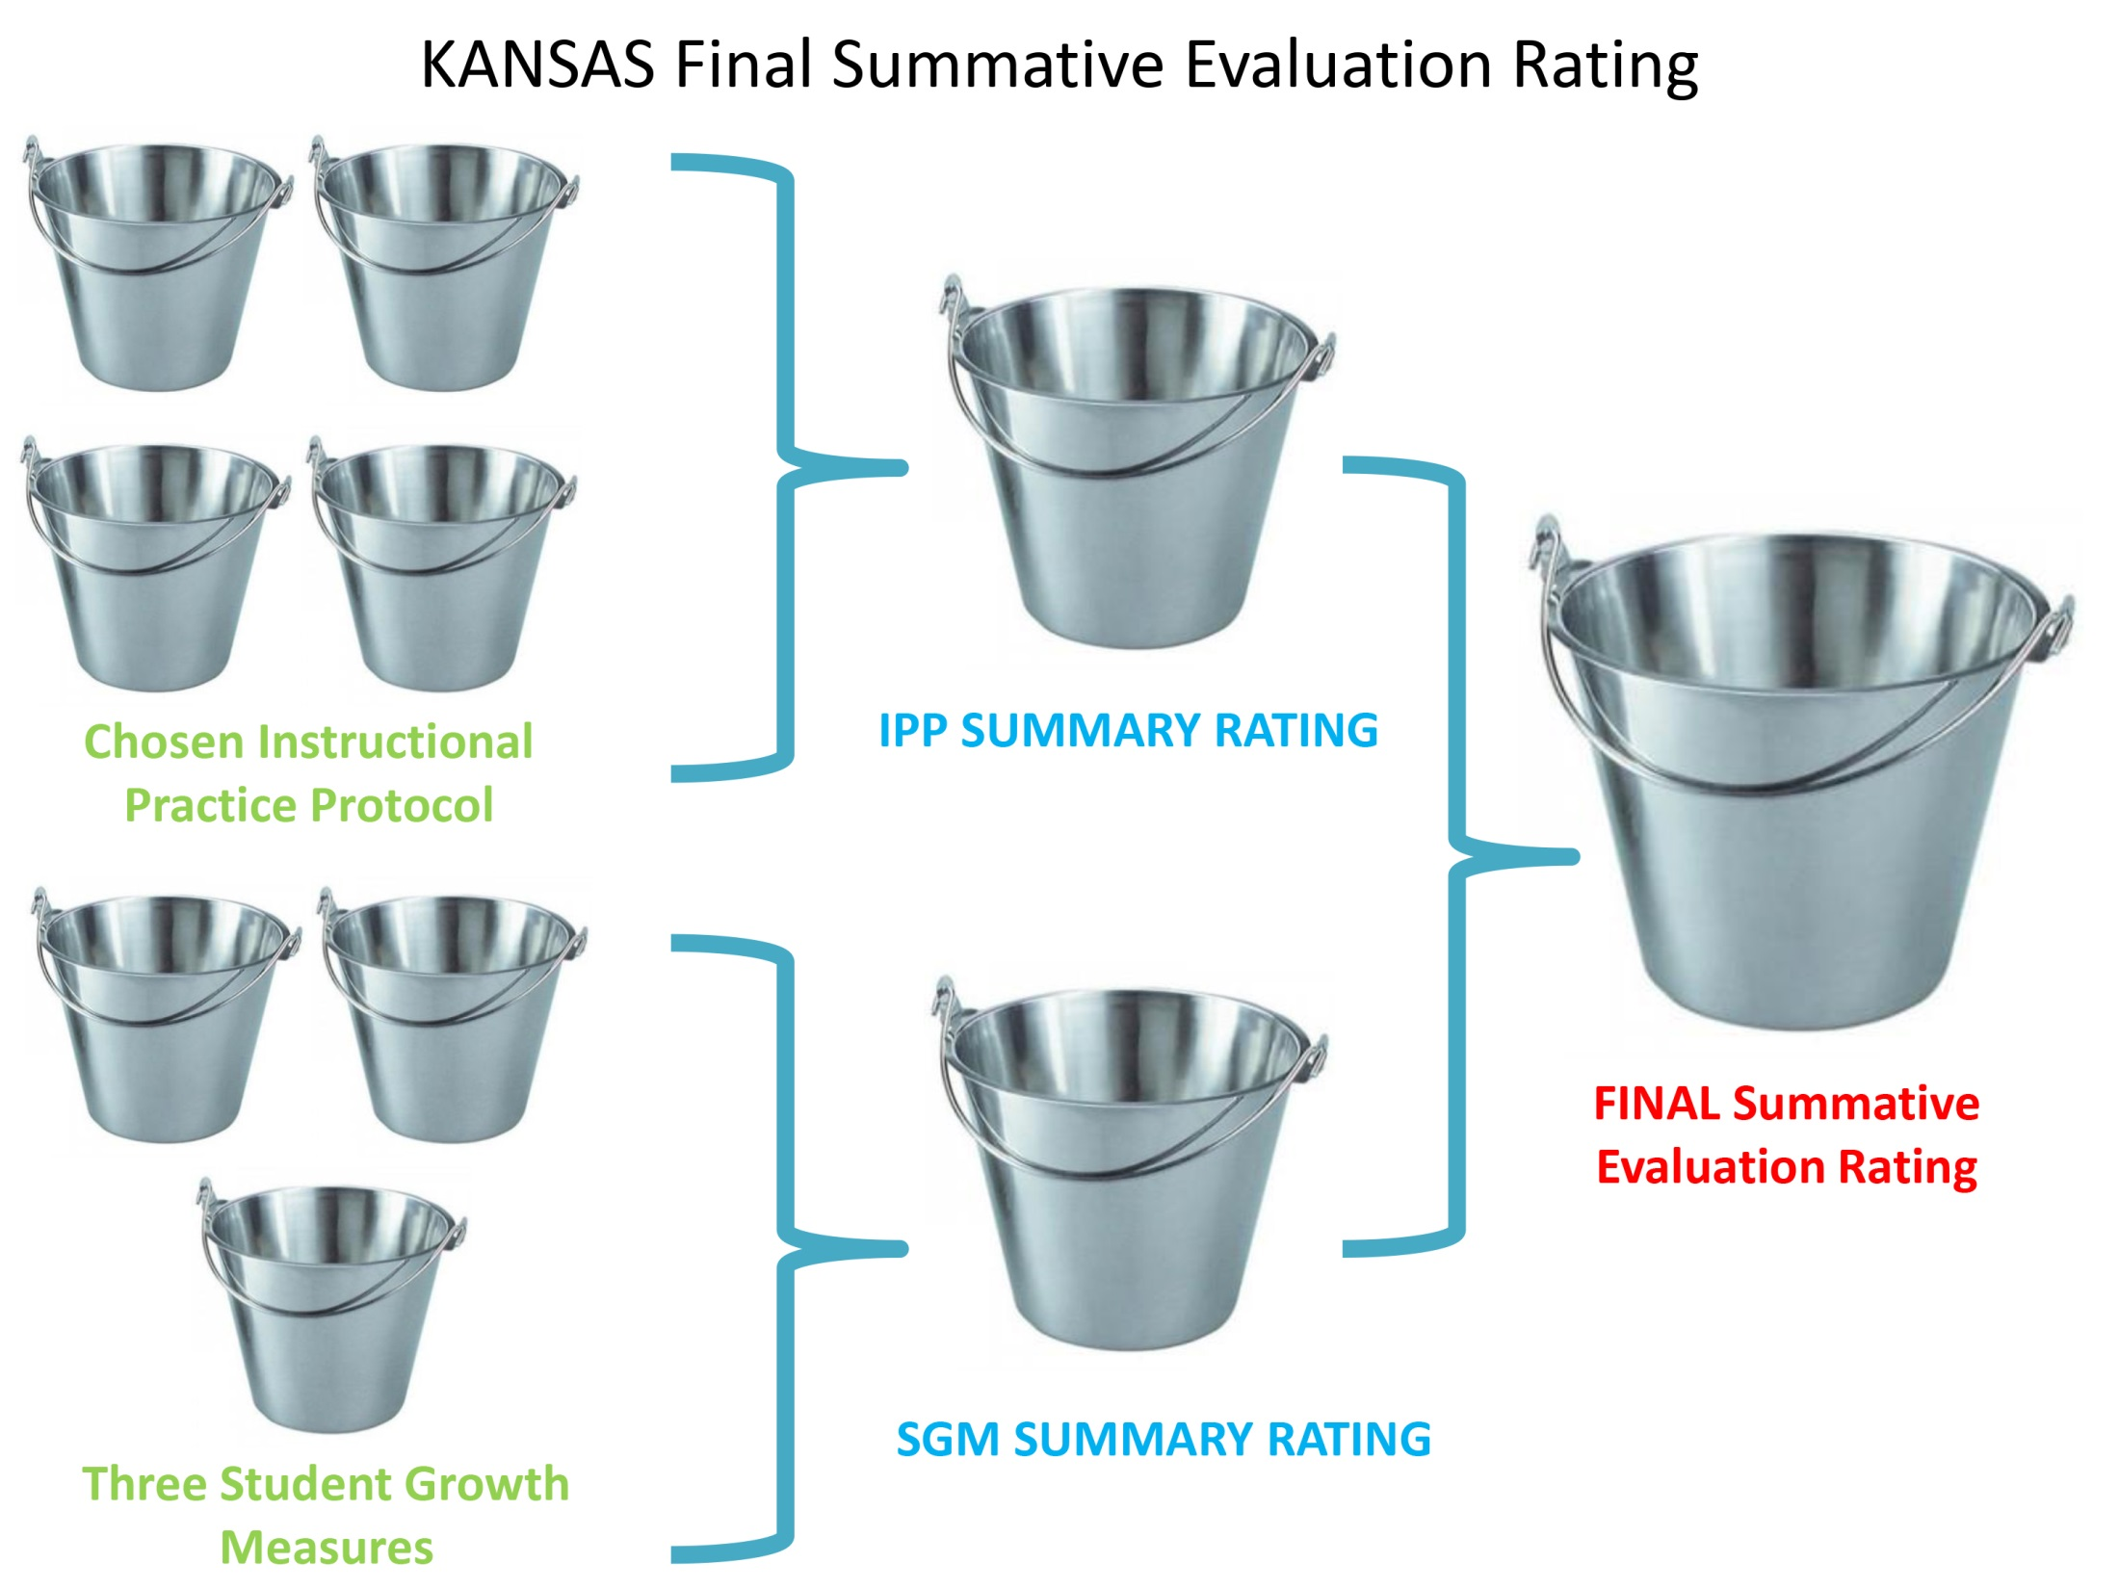

Slide 9

Defining Significant
The change in student achievement for an individual student between two or more points in time, determined using multiple measures
To include progress in academic and functional goals in an individualized education program or meeting academic student growth objectives
Educators will demonstrate significance by showing gains using 2 or more measures of student growth

Slide 10
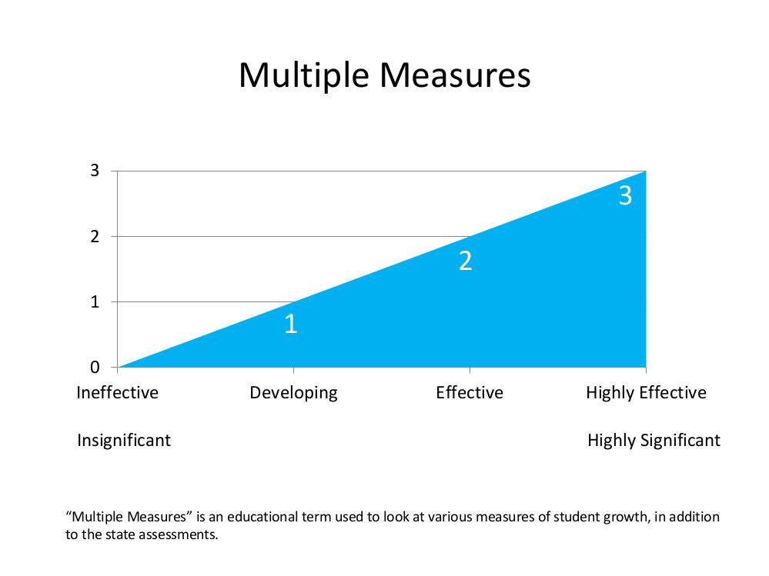
Multiple Student Growth Measures

Slide 11
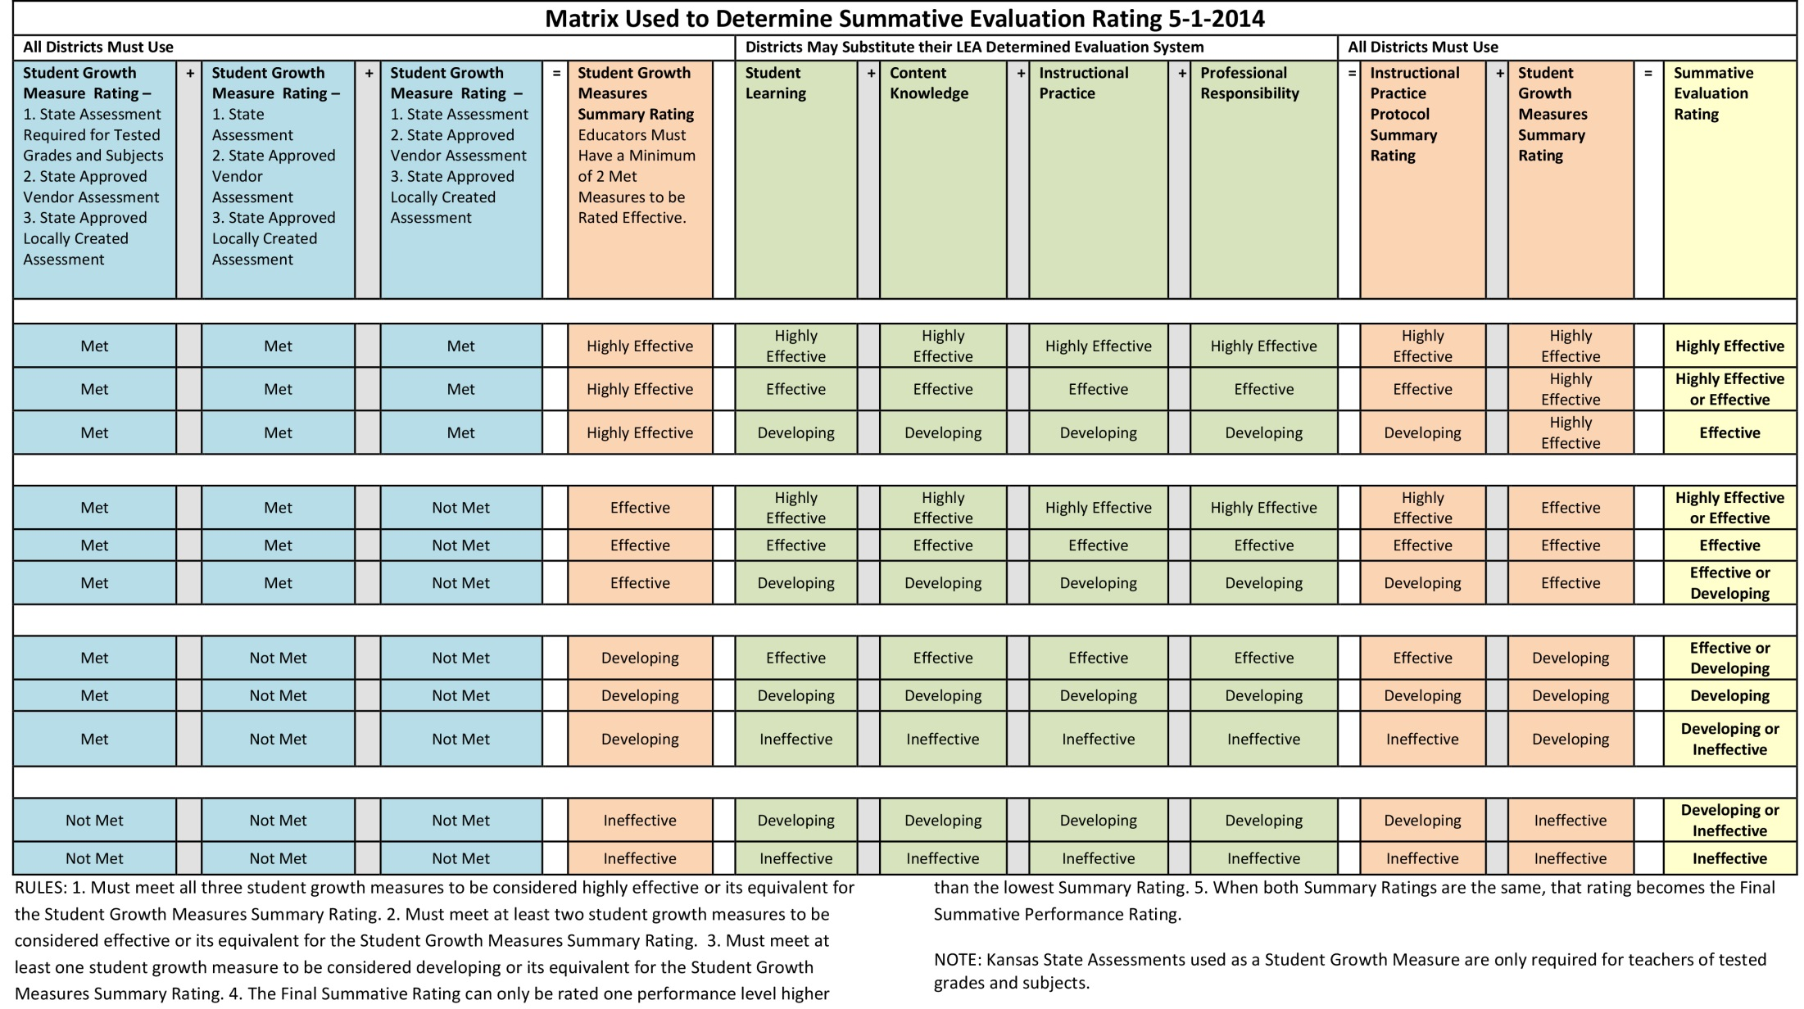
Matrix Used to Determine Summative Evaluation Rating

Slide 12
Matrix Rules
RULES:
1. Must meet all three student growth measures to be considered highly effective or its equivalent for the Student Growth Measures Summary Rating.
2. Must meet at least two student growth measures to be considered effective or its equivalent for the Student Growth Measures Summary Rating.
3. Must meet at least one student growth measure to be considered developing or its equivalent for the Student Growth Measures Summary Rating.
4. The Final Summative Rating can only be rated one performance level higher than the lowest Summary Rating.
5. When both Summary Ratings are the same, that rating becomes the Final Summative Performance Rating.
NOTE: Kansas State Assessments used as a Student Growth Measure are only required for teachers of tested grades and subjects.

Slide 13
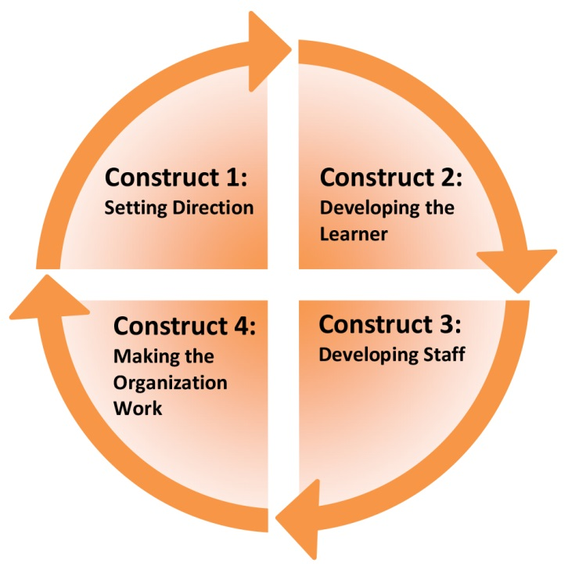
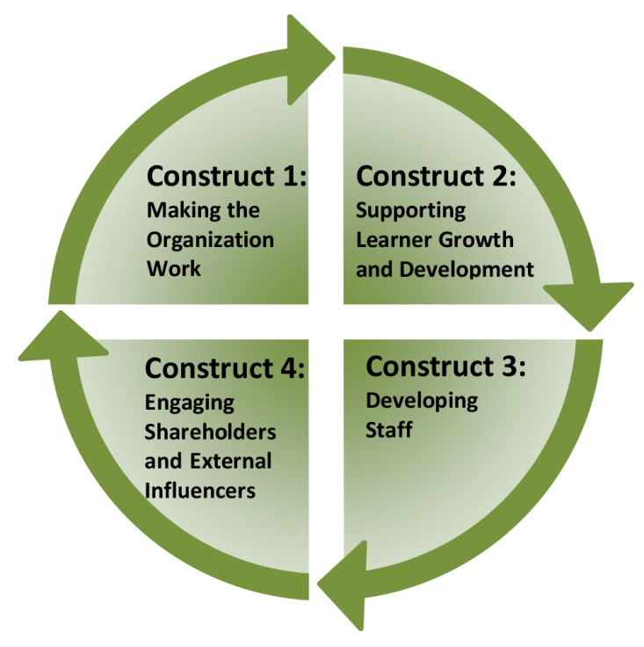
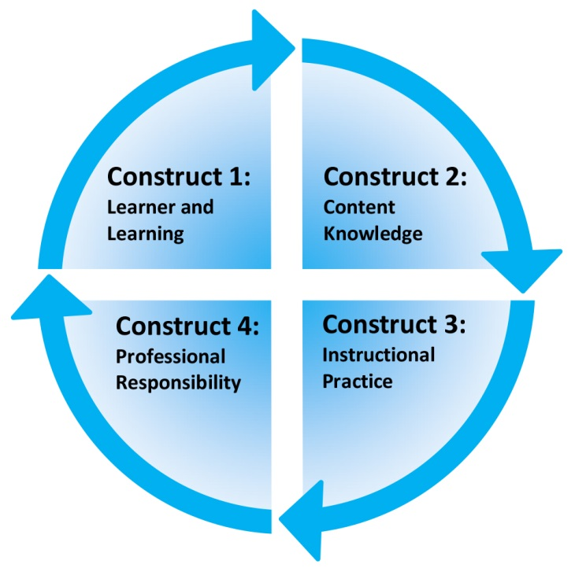
Rubrics Constructs
TEACHER BUILDING LEADER DISTRICT LEADERS

Slide 14
Number of Performance Ratings Used in Kansas
Name of Evaluation System 2014-2015 | Number of Performance Ratings 2014-2015 | Title of Lowest Performance Rating |  |  | Title of Highest Performance Rating for 4 Ratings | Title of Highest Performance Rating for more than 4 Ratings
KEEP | 4 | Ineffective | Developing | Effective | Highly Effective
McREL | 5 | Not Demonstrated | Developing | Proficient | Accomplished | Distinguished
e4E | 4 | Novice | Developing | Proficient | Distinguished
Greenbush | 4 | Ineffective | Developing | Effective | Highly Effective
Danielson | 4 | Unsatisfactory | Basic | Proficient | Distinguished
OASYS | 4 | Ineffective | Developing | Effective | Highly Effective
PD 360 Teacher Effectiveness Framework | 4 | Not Meeting Standards | Approaching Standards | Effective | Distinguished
TCAS | 4 | Needs Assistance | Basic | Proficient | Distinguished
Marzano | 4 | Beginning | Developing | Applying | Innovating
Locally Created | varies | varies | varies | varies | varies | varies

Slide 15
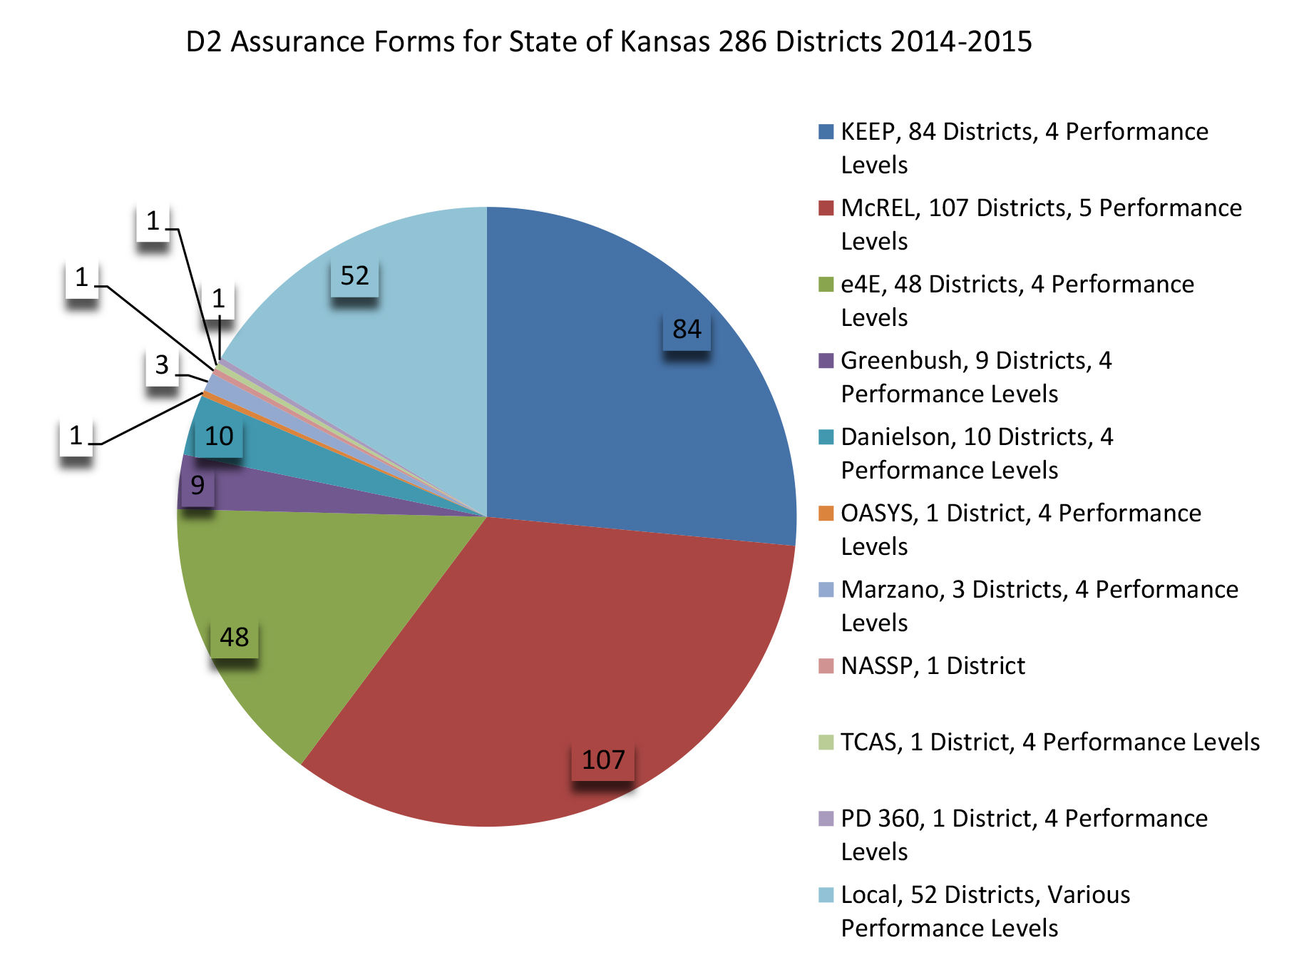
D2 Assurance Form Data 2014-2015,
as of 7/7/14

Slide 16
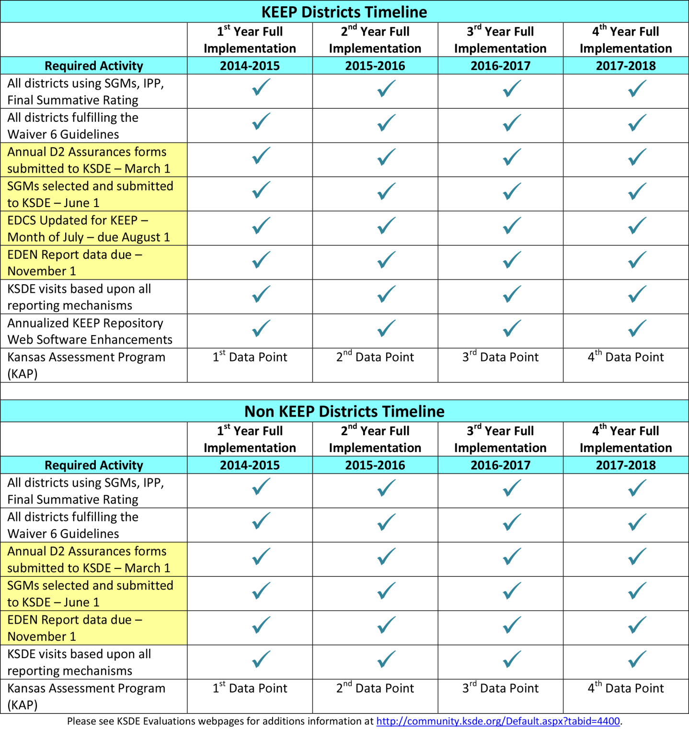
Annual Timeline
D2 Assurance Form – March 1
Annual KEEP Repository Enhancements – May 1
SGMs Online Form – June 1
EDEN Report – November 1

Slide 17

Questions??
Contact:
Bill Bagshaw, Assistant Director,
Teacher Licensure and Accreditation,
Kansas State Department of Education
bbagshaw@ksde.org
785.296.2198

