Slide 1
KEEP Debriefing 2014 February 19, 2014 Newman University, Wichita, KS
KSDE: Bill Bagshaw, Assistant Director, TLA and Kayeri Akweks, EPC, TLA
Shelley H. Billig, PhD, Vice President, RMC Research Corporation
Trudy L. Cherasaro, PhD, Senior Researcher, Marzano Research Laboratory

Slide 2
Welcome to KEEP Debriefing 2014
Introductions
Review the Agenda
Coffee, Water, Facilities
Lunch Location – Newman University Student Union Cafeteria
Breaks

Slide 3
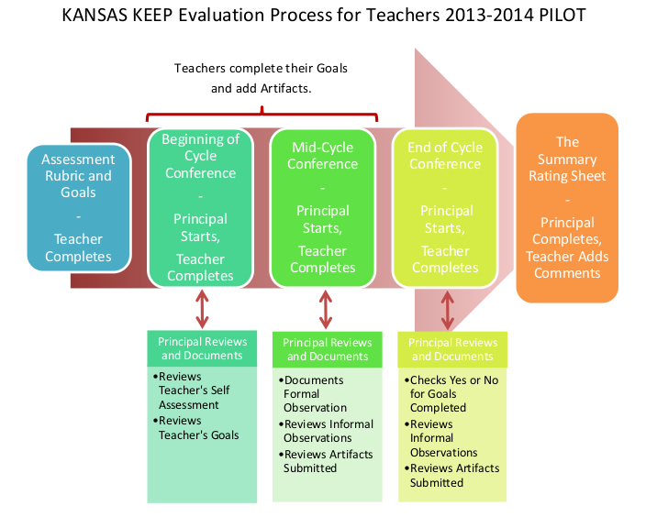
KEEP - Instructional Practice Protocol

Slide 4
Teacher Survey Results

Slide 6
What subject/content area do you currently teach? n=831
Content Area | Number
Language Arts/Reading | 340
Math | 320
Science | 277
Social Studies | 281
Art | 78
Health | 71
Physical Education | 49
Music | 33
Technology | 128
World Languages | 21
Other | 75
What grade level(s) do you currently teach? n=830
Grade | Number
Early Childhood | 17
Kindergarten | 127
1st Grade | 135
2nd Grade | 133
3rd Grade | 136
4th Grade | 135
5th Grade | 134
6th Grade | 142
7th Grade | 168
8th Grade | 174
9th Grade | 191
10th Grade | 218
11th Grade | 227
12th Grade | 207
Other | 46
What is your current role? n=831
Role | Number
Classroom teacher | 648
ELL Teacher | 16
Special Education Teacher | 73
Intervention Teacher | 42
Librarian | 15
Gifted and Talented Teacher | 5
Other | 69

Slide 10
Did you attend an orientation to KEEP? n=831
Answer | Number
No | 126
Yes, hosted by KSDE | 40
Yes, hosted by my district | 460
Yes, hosted by my school | 296
Yes, hosted by another source | 13

Slide 14
Principal Survey Results

Slide 15
What grade levels does your building serve?
Did you attend training on the KEEP system for evaluating teachers?
Grade Level | Number
PreK | 21
Primary | 52
Intermediate | 50
Middle School | 36
High School | 42
Answer | Number
I did not attend KEEP training. | 9
I attended training provided by the state. | 52
I attended training provided by my district. | 63
I attended training provided by another source. | 20

Slide 20
Questions ??
Bill Bagshaw, bbagshaw@ksde.org
Kayeri Akweks, kakweks@ksde.org

